Slide 1
Central Processing Unit (CPU) Basics
The computer’s CPU fetches, decodes, and executes program instructions.
The two principal parts of the CPU are the datapath and the control unit.
The datapath consists of an arithmetic-logic unit (alu) and storage units (registers) that are interconnected by a data bus that is also connected to main memory.
Various CPU components perform sequenced operations according to signals provided by its control unit.

Slide 2
CPU Basics
Registers hold data that can be readily accessed by the CPU.
The arithmetic-logic unit (ALU) carries out logical and arithmetic operations as directed by the control unit.
The control unit determines which actions to carry out according to the values in a program counter (PC) register and a status register.

Slide 3
Clocks
Every computer contains at least one clock that synchronizes the activities of its components.
A fixed number of clock cycles are required to carry out each data movement or computational operation.
The clock frequency, measured in megahertz or gigahertz, determines the speed with which all operations are carried out.
Clock cycle time is the reciprocal of clock frequency.
An 800 MHz clock has a cycle time of 1.25 ns.

Slide 4
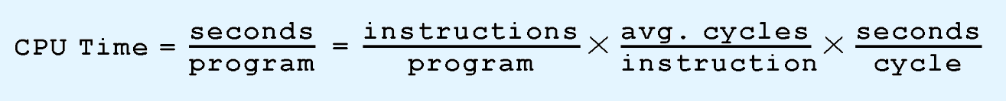
Clocks
Clock speed should not be confused with CPU performance.
The CPU time required to run a program is given by the general performance equation:
We see that we can improve CPU throughput when we reduce the number of instructions in a program, reduce the number of cycles per instruction, or reduce the number of nanoseconds per clock cycle.

Slide 5
Clock Speed
Two machines with the same clock cycle don't necessarily execute instructions in the same number of cycles
Multiply Operation
An old Intel 286 machine required 20 clock cycles
Newer intel can do in 1 clock cycle

Slide 6
Example
A program consists of 1 billion instructions. It executes on a processor running at 2 GHz. Suppose that each of the instructions execute in 4 clock cycles. What is the execution time for the program?
10⁹ instructions x 4 cycles/instruction x(.5 x 10⁻⁹ seconds/cycle) = 2 seconds
2 GHz = 2 billion Hz = ½ billion HZ

Slide 7
The Input/Output Subsystem
A computer communicates with the outside world through its input/output (I/O) subsystem.
I/O devices connect to the CPU through various interfaces.
I/O can be memory-mapped-- where the I/O device behaves like main memory from the CPU’s point of view.
Each CPU has a specific instruction set that can include special I/O instructions

Slide 8
Memory Organization
Computer memory consists of a linear array of addressable storage cells that are similar to registers.
Main Memory is constructed of RAM chips, often referred to in terms of length × width or N x n.
n is bit width 8,16,32
N is number of memory locations
m is number of address bits N = 2^{m}

Slide 9
Example
1k x 8 RAM 10 addr lines, 8-bit of data per memory location
2¹⁰ = 1k (1024) mem locations = length
width = 8-bit, size = 1k-byte, 8k-bits

Slide 10
Instruction Set Architecture
A computer’s instruction set architecture (ISA) specifies the format of its instructions and the primitive operations that the computer can perform.
The ISA is an interface between a computer’s hardware and its software.
Some ISAs include hundreds of different instructions for processing data and controlling program execution.

Slide 11
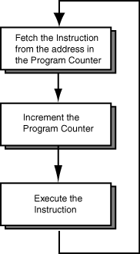
Basic Machine Cycle
Most processors endlessly repeat three basic steps. Each machine cycle results in the execution of one machine instruction. A modern processor performs billions of machine cycles per second. A machine instruction is a pattern of bits 1. Fetch the Instruction. The instruction is fetched from memory. The program counter (PC) is part of the processor. It contains the address of the instruction in memory. 2. Increment the Program Counter. The program counter now points to the next instruction. 3. Execute the Instruction. The operation asked for by the current machine instruction is performed.

Slide 12
Instruction Processing
The fetch-decode-execute cycle is the series of steps that a computer carries out when it runs a program.
We first have to fetch an instruction from memory, and place it into the IR.
Once in the IR, it is decoded to determine what needs to be done next.
If a memory value (operand) is involved in the operation, it is retrieved and placed into the MBR.
With everything in place, the instruction is executed.

Slide 13
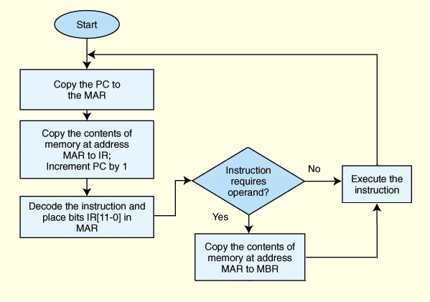
Instruction Processing

Slide 14
Computer Architecture
The architecture of a computer is a description of its components and its basic operations.
Assembly language is used to write programs in terms of the basic operations of a processor.
When a programmer writes in assembly language the programmer is asking for the basic operations of the processor. The architecture of the processor is visible in every statement of the program.

Slide 15
High Level Languages
Most application programs are written in a high level language.
Programs in high level languages such as C, Java, or Python are (mostly) independent of the processor they run on.

Slide 16
Different Processor Architectures
Each family of processor chip (MIPS, PIC, SPARC, Alpha, Motorola, Intel, et al.) has its own architecture
Each type of processor has its own assembly language.When you study an assembly language, you study the architecture of a particular processor.
Computer scientists understand computers at many levels. They understand how the many levels are built one on top of another. Each of these levels corresponds to one or more courses in a computer science degree program.

Slide 17
Machine Instructions
Instructions are normally executed in sequence. The program counter advances forward through memory one instruction at a time. Each time an instruction is executed, the next one is automatically selected for the next execution cycle. Operations like "add two integers" and "compare two integers" are operations that a processor does in one machine cycle. Loops and branches require machine instructions that alter the normal sequence. A machine instruction is a pattern of bits that directs the processor to perform one machine operation. Here is the machine instruction that directs a 32-bit processor to add two 32-bit registers together (a register is a part of the processor that holds a bit pattern). 0000 0001 0010 1011 1000 0000 0010 0000 Some of the bits in the instruction specify the operation (adding two registers), other bits specify which two registers to add. A few more bits say were to put the result.On a 32-bit processor, memory addresses are 32 bits wide and so the program counter (PC) holds a 32 bit address.

Slide 18
Assembly Language Statement
The layout of a machine instruction is part of the architecture of a processor chip. Without knowing the layout you can't tell what the instruction means. A statement in assembly language corresponds to one machine instruction. Assembly language is much easier to write than machine language. Here is the previous machine instruction and the assembly language that it corresponds to:

Slide 19
Example Instruction
machine instruction assembly language statement 0000 0001 0010 1011 1000 0000 0010 0000 add $t0,$t1,$t2
The instruction means: add the integers in registers $t1 and $t2 and put the result in register $t0. To create the machine instruction from the assembly language statement a translation program called an assembler is used.

Slide 20
Assembly Language vs. Machine Language
Humans find assembly language much easier to use than machine language for many reasons. It is hard for humans to keep track of those ones and zeros.
By using symbols programmers gain flexibility in describing the computation.

Slide 21
High-Level vs. Low-Level Language
Assembly language describes computations in terms of the hardware of a particular processor.
A high level computer programming language (ideally) describes computations in terms of the problem being solved .
Since there are many types problems, there are many high level languages, each designed for particular types of problems. For example, object-oriented languages, describe computations in terms of the objects of the problem and operations with them.

Slide 22
Assembly Applications
Assembly language does match the problem when the problem is the operation of the computer system.
Assembly language is used for operating systems, compilers, communications, low-level graphics, and other programs where the architecture of the processor must be visible. Often with these program the crucial parts are written in assembly and the rest in a high level language (usually C).
The most common use of assembly language is in programming embedded systems. Here a processor chip is part of a machine built for a specific purpose. Examples are aviation electronics, communication satellites, DVD players, robots, automobile electronics, cell phones, and game consoles

Slide 23
Key Takeaways
The major components of a computer system are its control unit, registers, memory, ALU, and data path.
A built-in clock keeps everything synchronized.

Slide 24
Key Takeaways
Computers run programs through iterative fetch-decode-execute cycles.
Computers run programs that are in machine language.
An assembler converts mnemonic code to machine language.

Slide 25
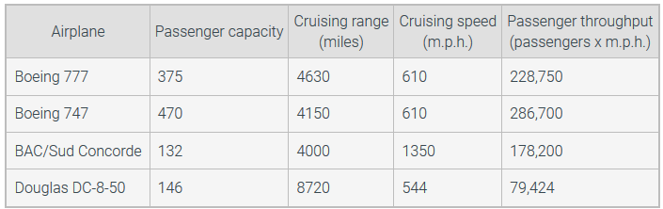
Performance
Response time: Also called execution time. The total time required for the computer to complete a task, including disk accesses, memory accesses, I/O activities, operating system overhead, CPU execution time, and so on.
Throughput: Also called bandwidth. Another measure of performance, it is the number of tasks completed per unit time.

Slide 26
Byte ordering
Byte ordering, or endianness, is another major architectural consideration.
If we have a two-byte integer, the integer may be stored so that the least significant byte is followed by the most significant byte or vice versa.
In little endian machines, the least significant byte is followed by the most significant byte.
Big endian machines store the most significant byte first (at the lower address).

Slide 27
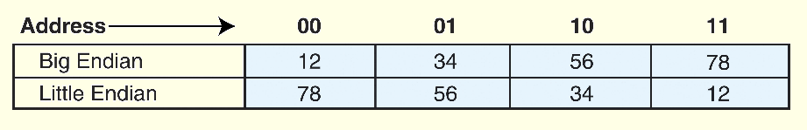
5.2 Instruction Formats
MSB
As an example, suppose we have the hexadecimal number 12345678
The big endian and small endian arrangements of the bytes are shown below.
LSB

Slide 28
5.2 Instruction Formats
Big endian:
Is more natural.
The sign of the number can be determined by looking at the byte at address offset 0.
Strings and integers are stored in the same order.
Little endian:
Makes it easier to place values on non-word boundaries.
Conversion from a 16-bit integer address to a 32-bit integer address does not require any arithmetic.

